Slide 1
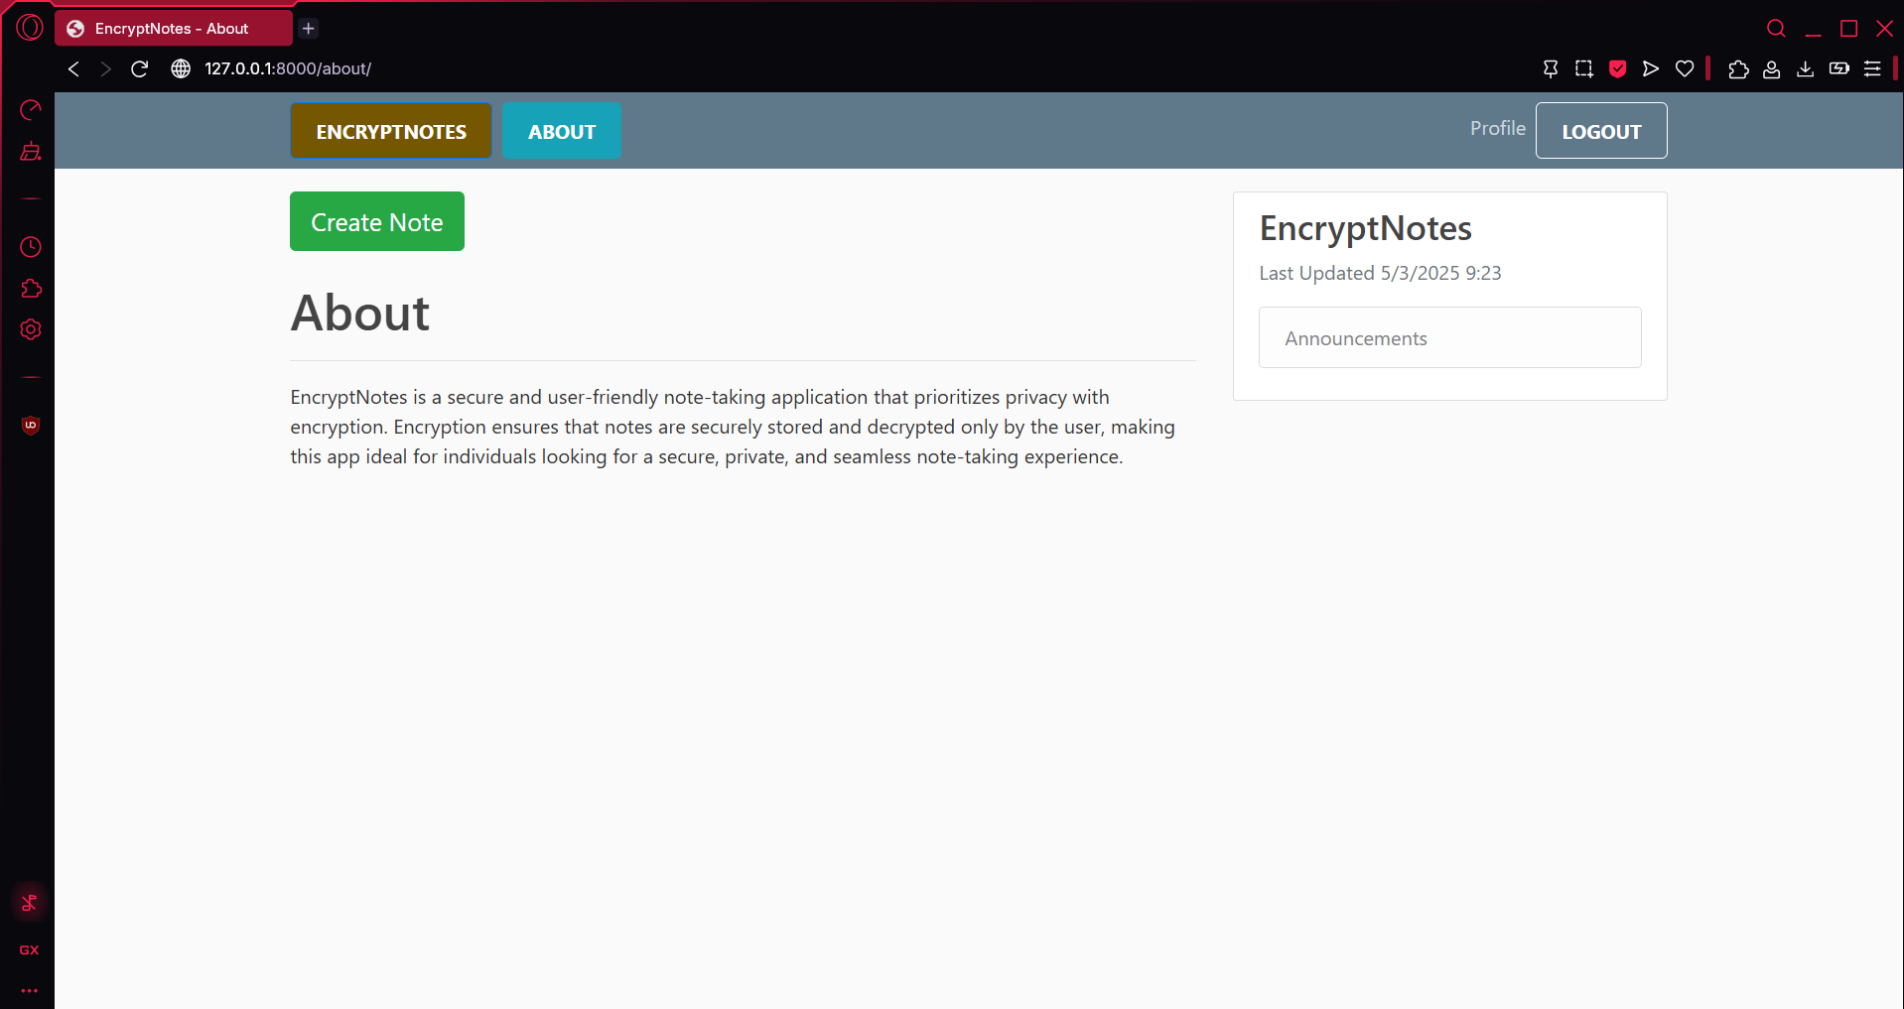
EnCryptNotes Secure and Intelligent Note Management
CPT-200 Team 2 - Phase 4

Slide 2

What is it?
EncryptNotes is secure note taking Web-App
It secures every note you make
Privacy & efficiency are top priorities

Slide 3

Why a Website?
It’s a website, because we thought it was the best place to have
No, downloading needed
It allows for easy access
It gave us a good environment to develop and create our application

Slide 4
Key Features
End to End Encryption
AI-Powered Categorization
User-Controlled Security Setting
Note Editing and Management
User Account Controls

Slide 5
Technical Overview
Application
Powered by Python and Django
User Authentication
Secure authentication with Django
Encryption
Data encrypted before saving to database
Decrypted upon access from database
AI Integration
AI powered note categorization with Google

Slide 6
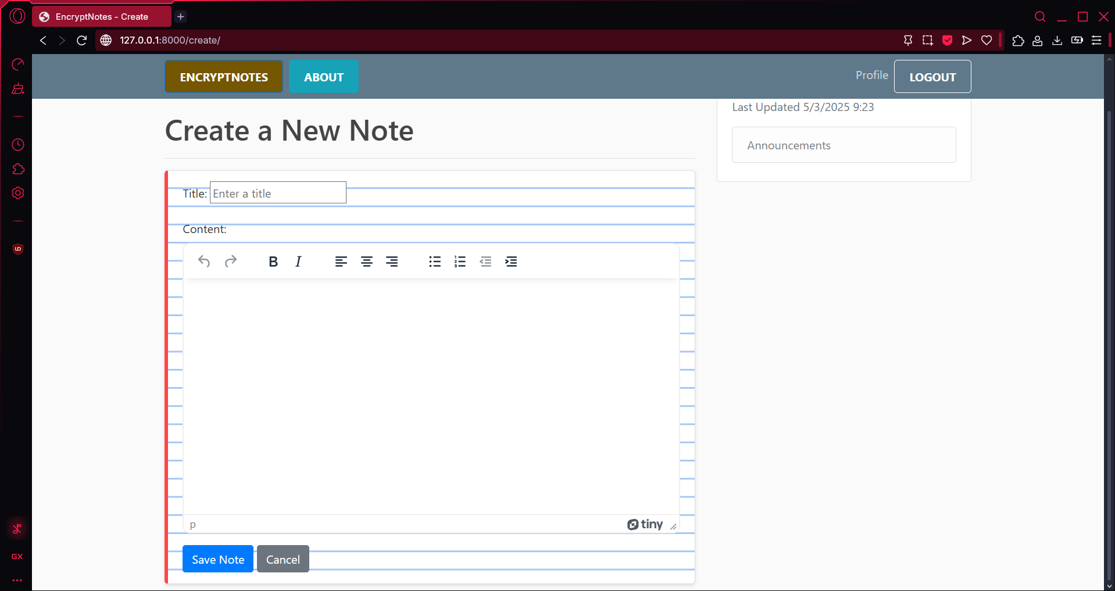
Unique Features
Powerful TinyMCE Editor utilized for create, edit, and view

Slide 7
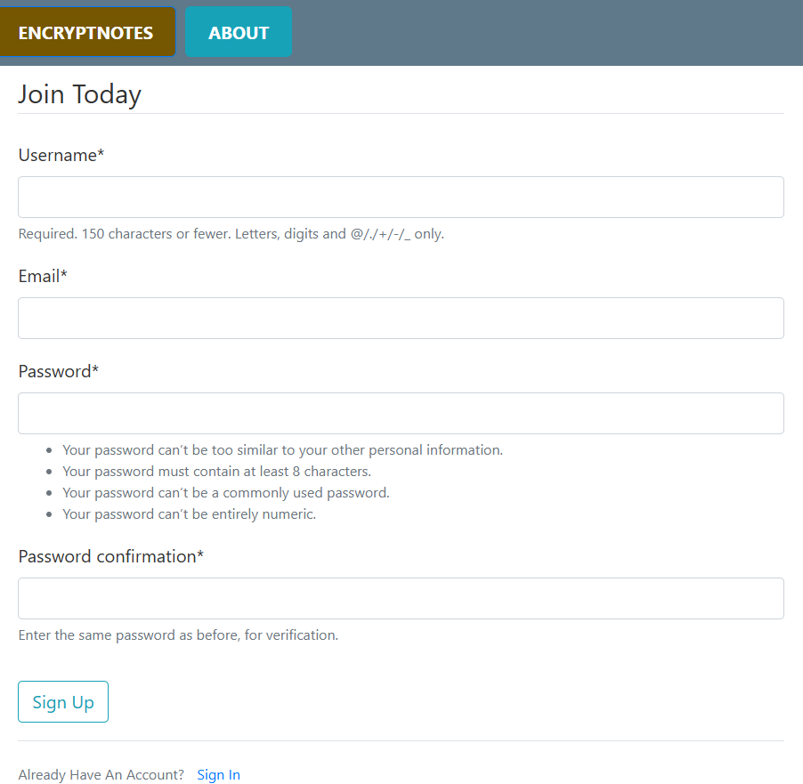
Unique Features Sign Up Page
Minimum password requirements for enhanced security

Slide 8

Who would use it?
Students – Secure College Notes
Business Professionals – Secure Work Notes
Other Privacy Focused Individual Users

Slide 9
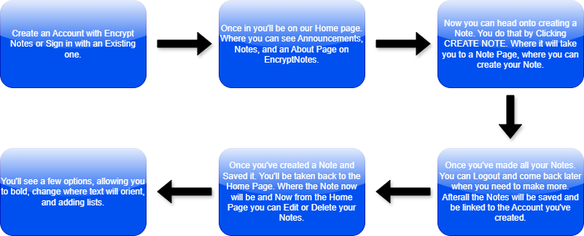
So How Do You Use It?

Slide 10
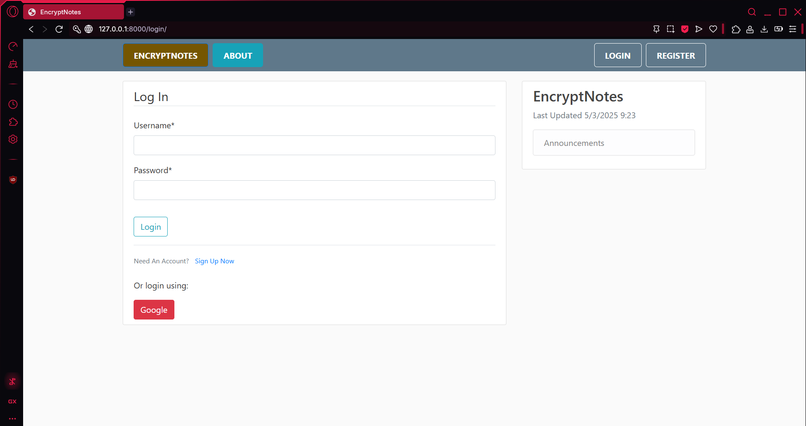
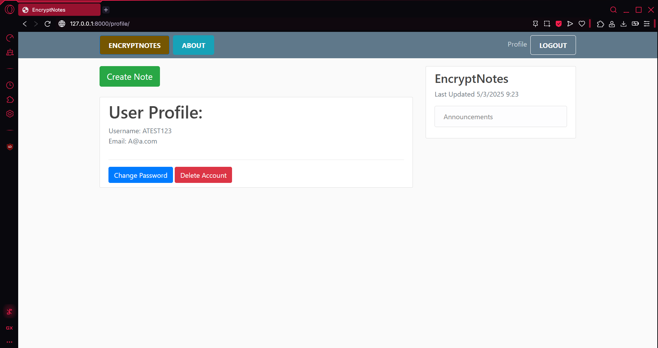
Login/profile page
Here is an Image of the second step.
This is showing the Login page and User page once Logged in.

Slide 11
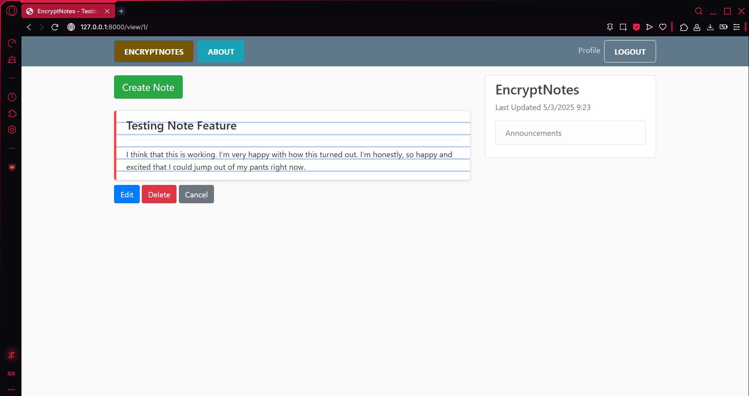
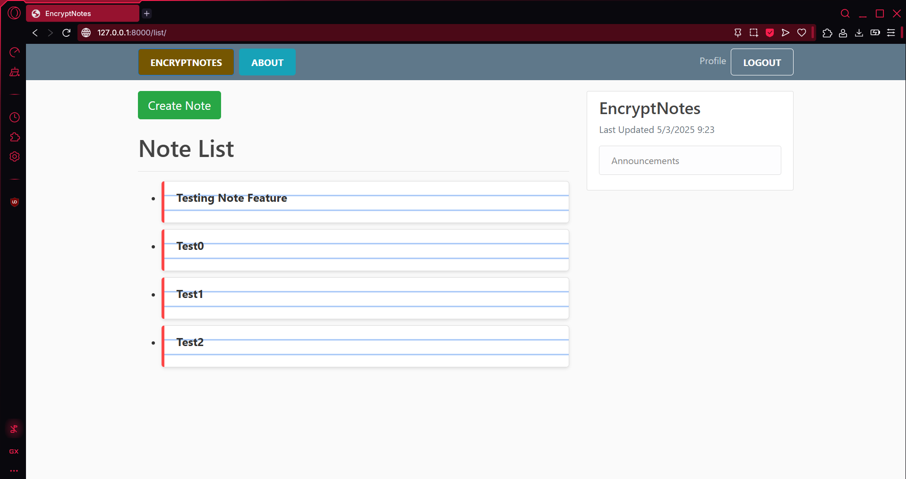
Note Pages

Slide 12
Demo

